Slide 1

Vehicle Status Change Analysis
-Pavan Naik

Slide 2
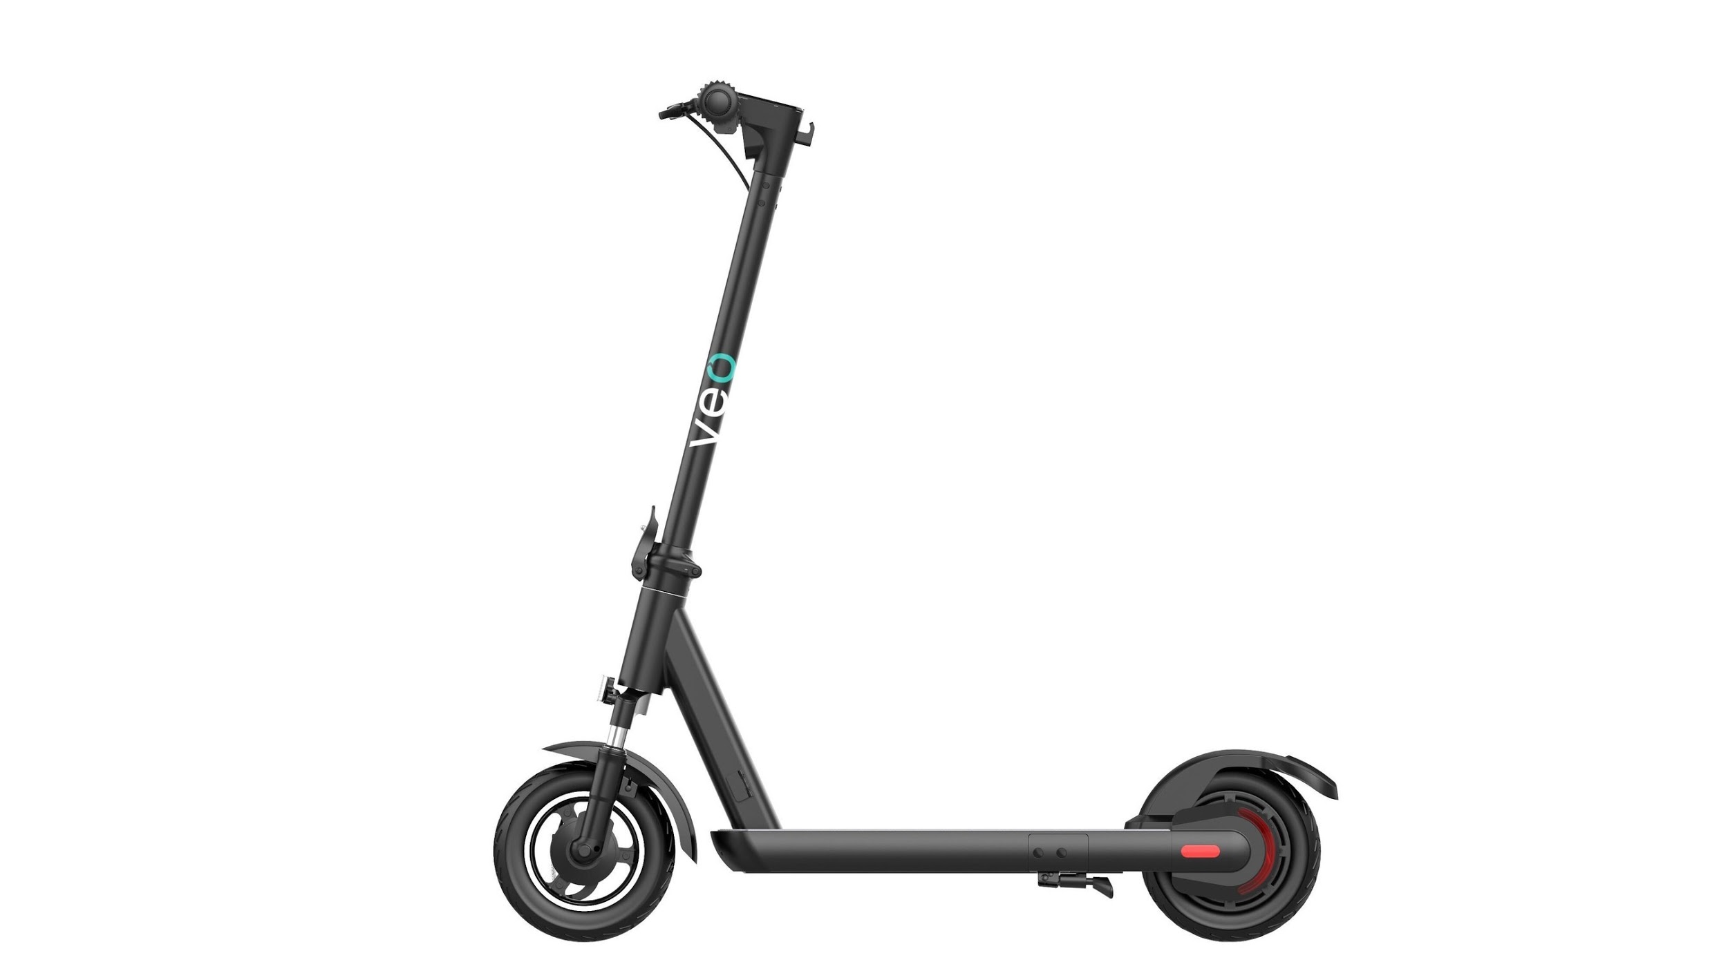
Table of Contents
Data Overview
Approach & Tools Used
Insights from data
Deep Analysis of Riders
Summary Stats

Slide 3
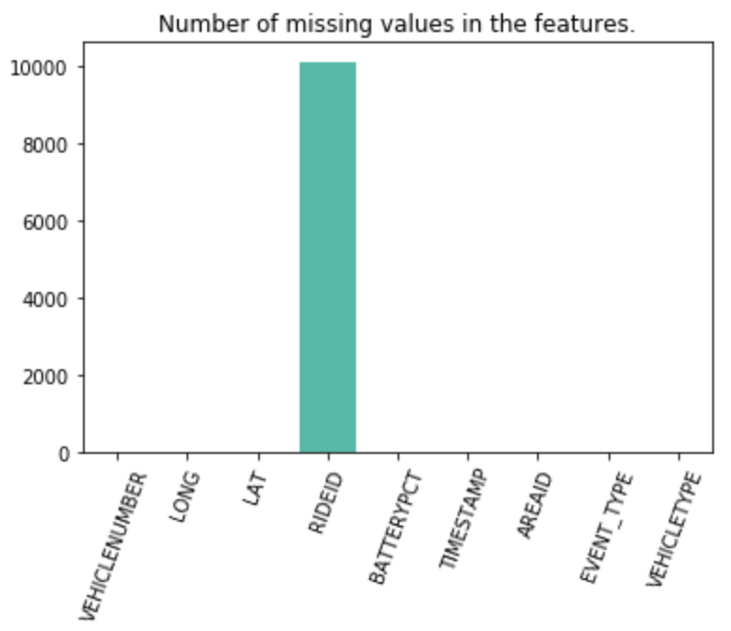
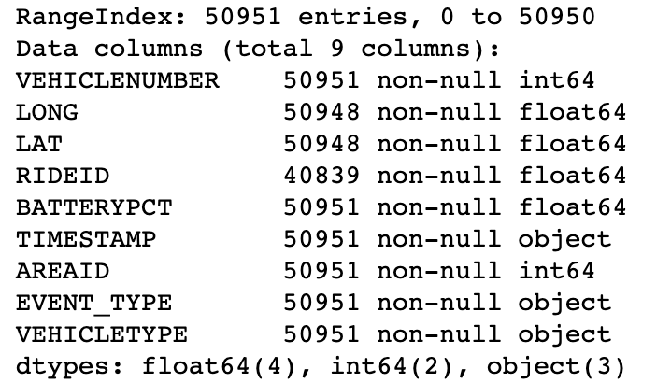
Overview of the Data
VEHICLENUMBER
LONG, LAT
RIDEID
BATTERYPCT
TIMESTAMP (UTC)
AREAID
EVENT_TYPE
VEHICLE_TYPE
The data comprises of:
50951 rows
9 columns
47446 Scooters
3505 Cosmos

Slide 4
TIMESTAMP (UTC) - Atlanta timezone
The dataset has been disseminated into 2 tables based on RIDEIDs
Event Type : Rides
Data comprising RIDEID
Event Type : Pick Up & Drop Off
Vehicle Type: Scooter/ Cosmo
No Null Values with 40839 rows
Event Type : Non - Rides
Data Table without RIDEID
Event Type : Low Battery, Maintenance, Rebalance, Swap Battery, Service
Vehicle Type: Scooter/ Cosmo
3 LAT & LONG missing with 10112 rows
191 Duplicate rows

Slide 5




Tools Used

Slide 6
Insights

Slide 7
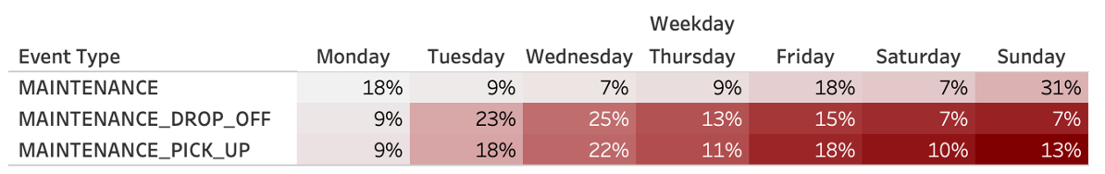
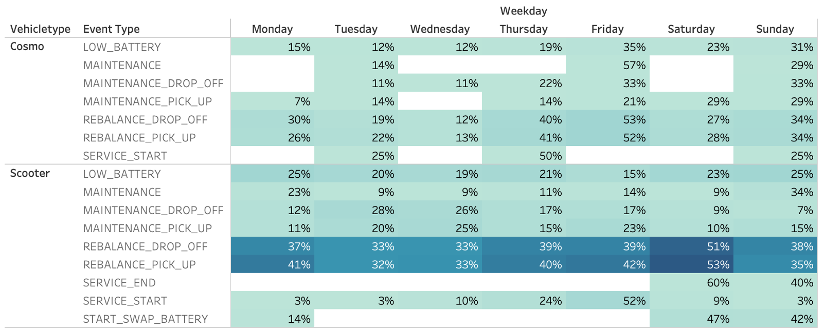
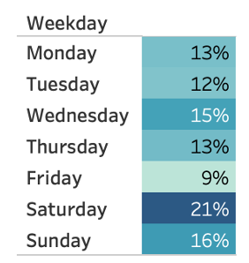
Non Rides - Insights
Percentage breakdown of maintenance through the week
Percentage breakdown of low battery vehicles through the week
Breakdown of all vehicle statuses through the week

Slide 8
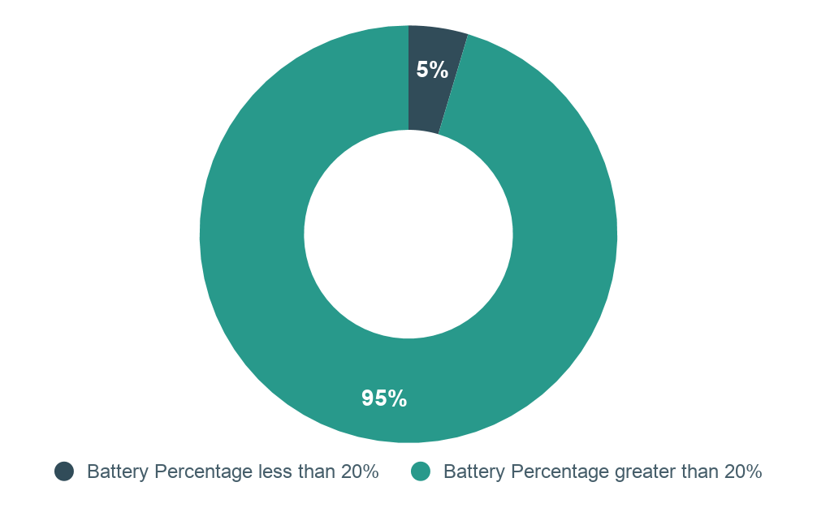
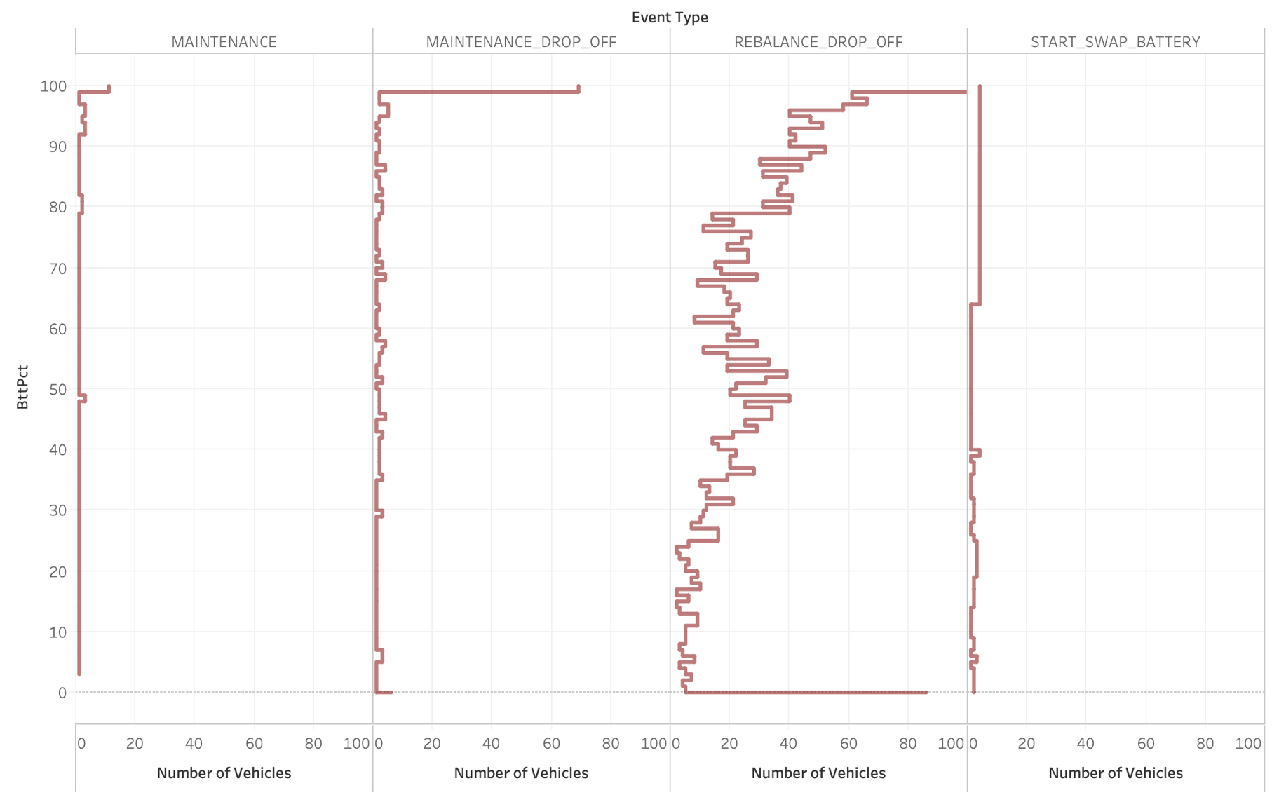
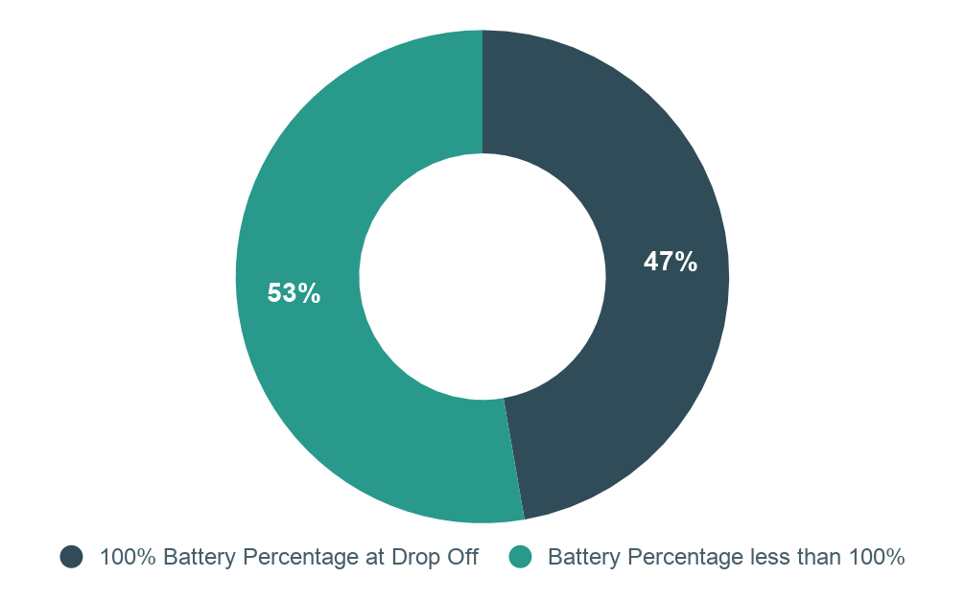
Battery Percentage
Drop Off with less than 20% battery
Drop Off with 100% battery

Slide 9
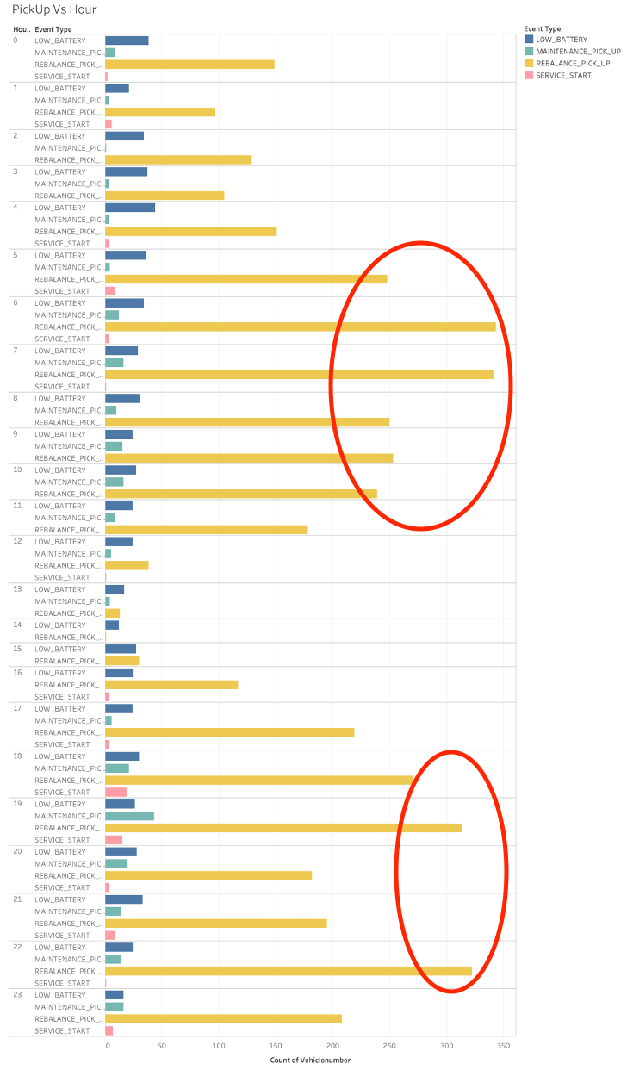
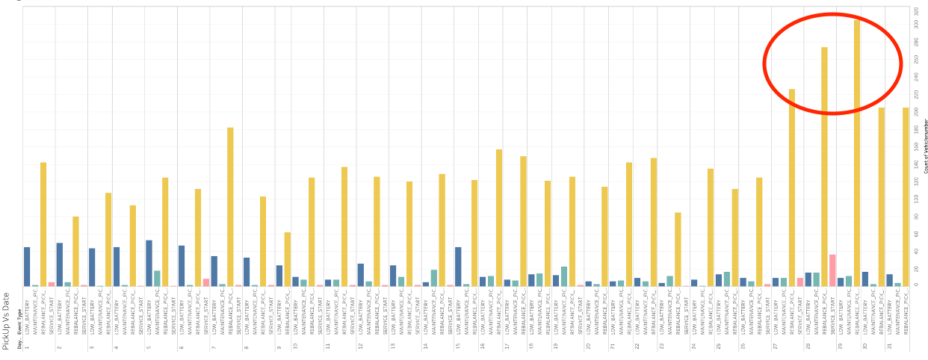
Non-Ride Events Vs Day & Hour of Day
Pick Up vs Hour of Day
Event Type : Non-Ride PickUp
Frequency of pickup events are higher towards the end of the month 08/27 - 08/31
Rebalance pickups are higher between 5 a.m. - 11 a.m. and 5 p.m - 11 p.m
Pick Up vs Date of Month

Slide 10
Deep Analysis of Rides

Slide 11
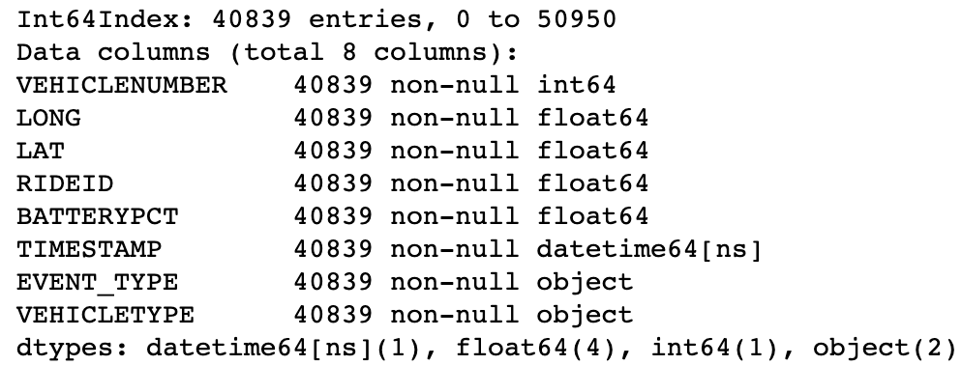
Rides Data Exploration
Event Type: Pick Up and Drop Off
Ride ID: Unique RideIDs for each Event
Convert RIDEID from float to int
Performed a join on RIDEID to generate Trip Duration for each ride.
TimeStamp : Stripped into Date, Day of Week, Hour of Day, Trip Duration in mins
Exploratory Data Analysis in Python and GeoSpatial Analysis in Tableau

Slide 12
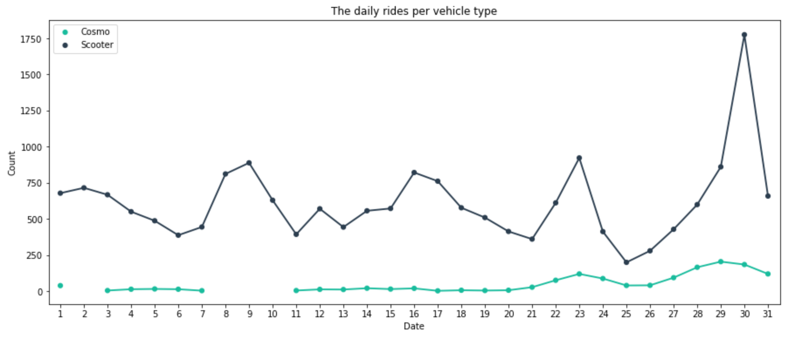
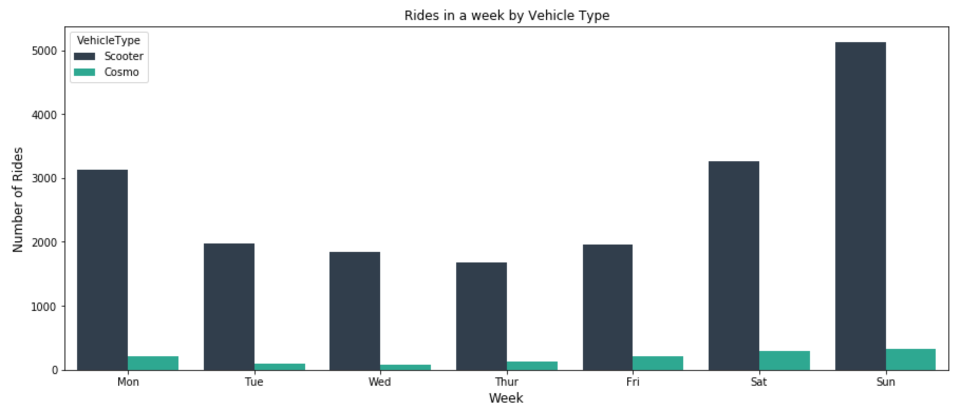
Overall Rides vs Vehicle Type

Slide 13
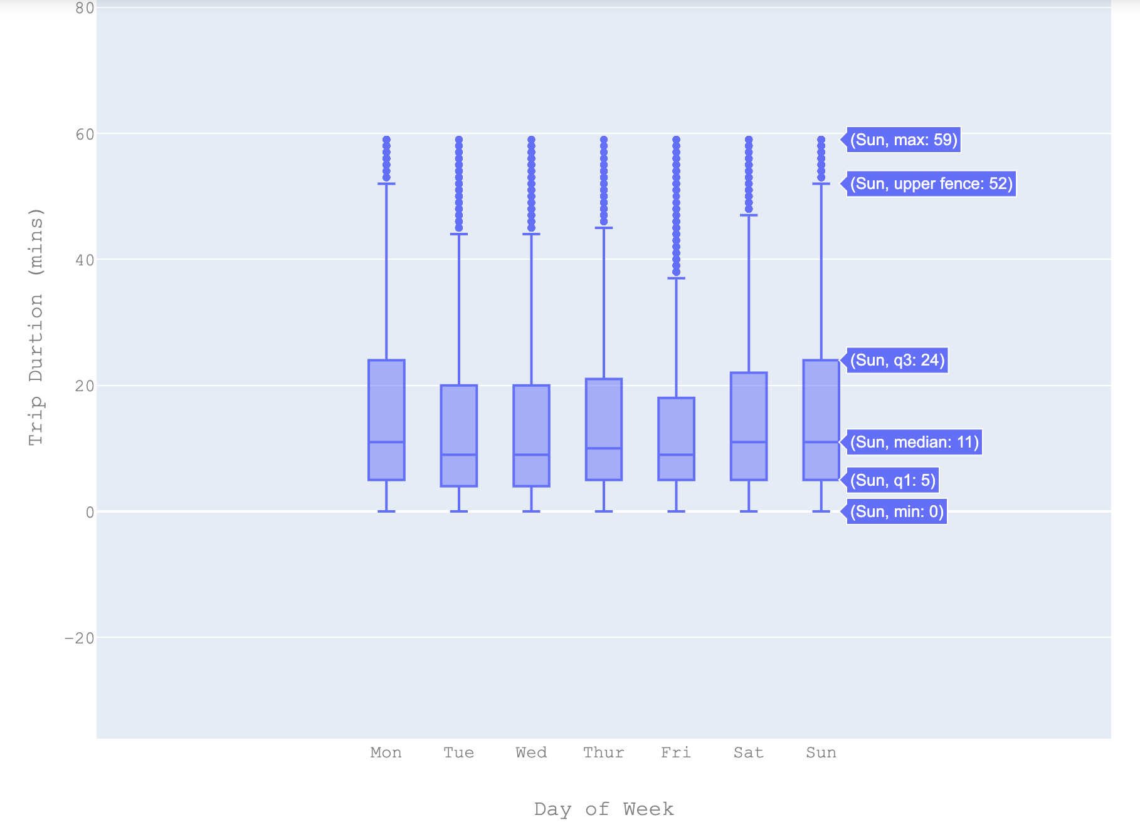
Trip Duration and Day of the Week

Slide 14
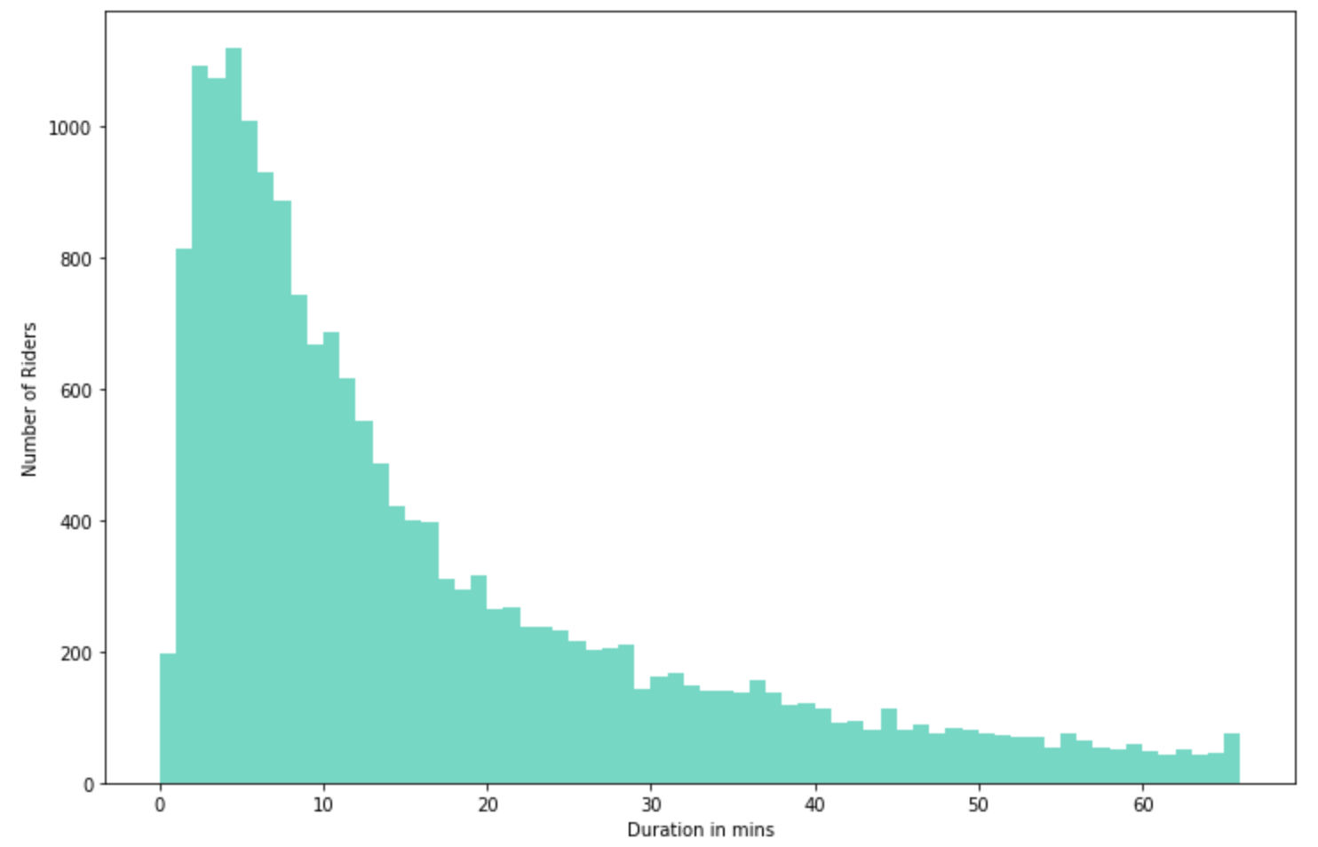
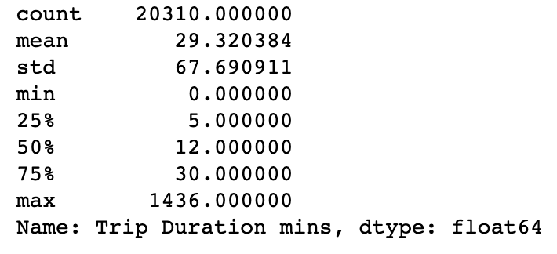
Number of Rides vs Trip Duration

Slide 15
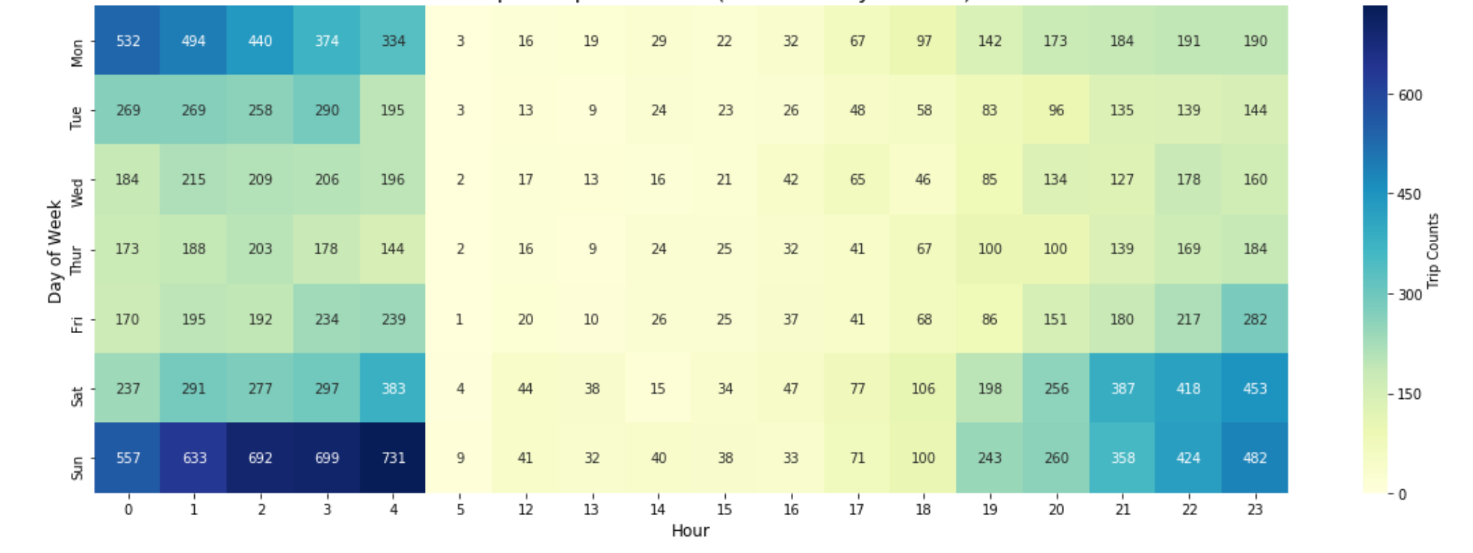
Frequency of Overall Rides by Days and Hour of Day

Slide 16
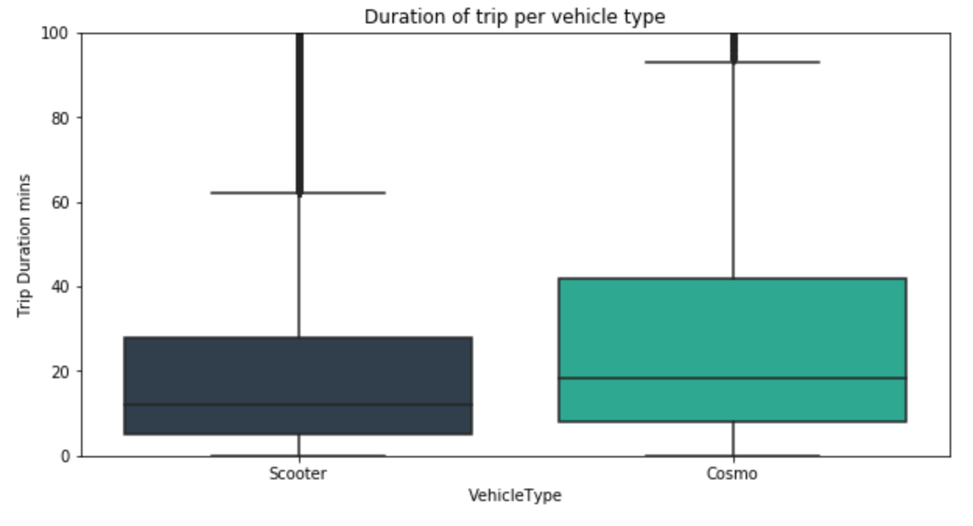
Trip Duration vs Vehicle Type
Trip duration of Scooters are less compared to that of Cosmos
Trip Durations are in the range of 5 to 30 mins for Scooters and 20 - 40 mins for Cosmos

Slide 17
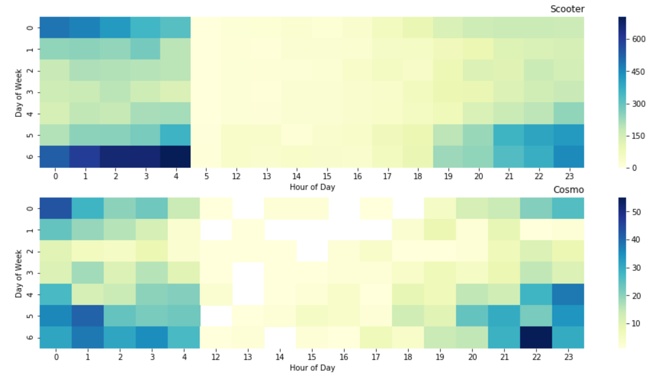
Vehicle Type & Frequency of Rides
0 | Monday
1 | Tuesday
2 | Wednesday
3 | Thursday
4 | Friday
5 | Saturday
6 | Sunday

Slide 18
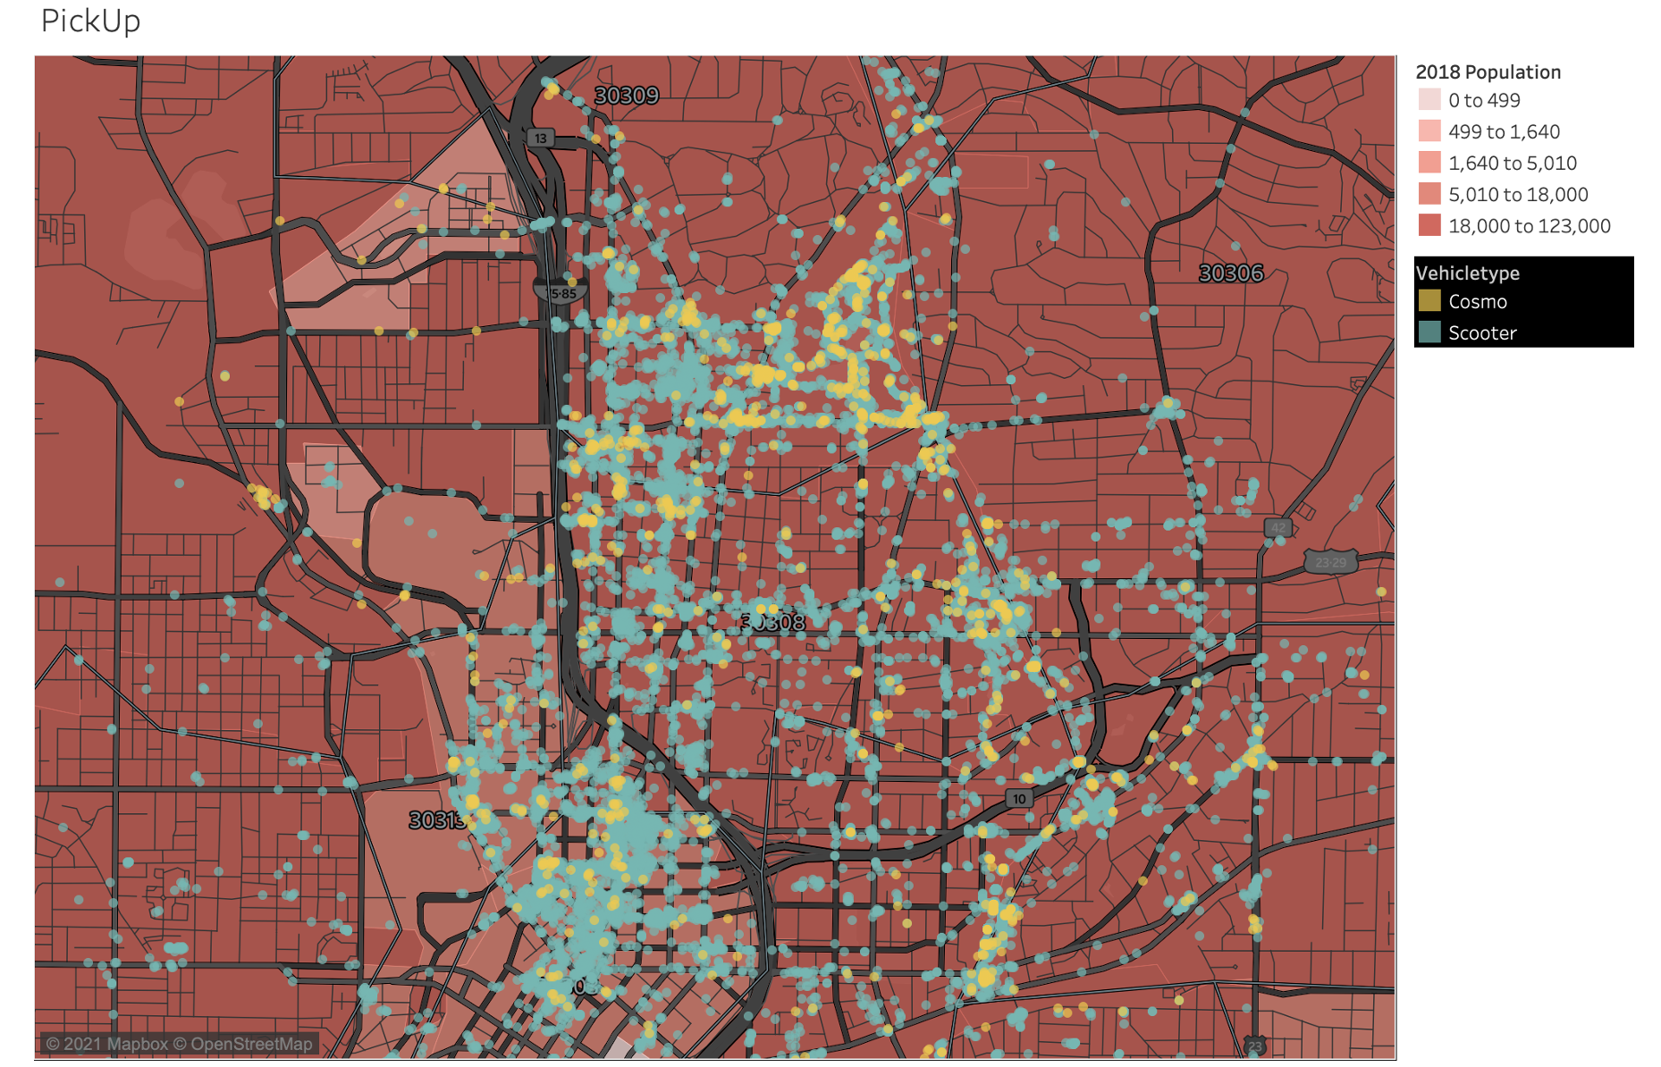
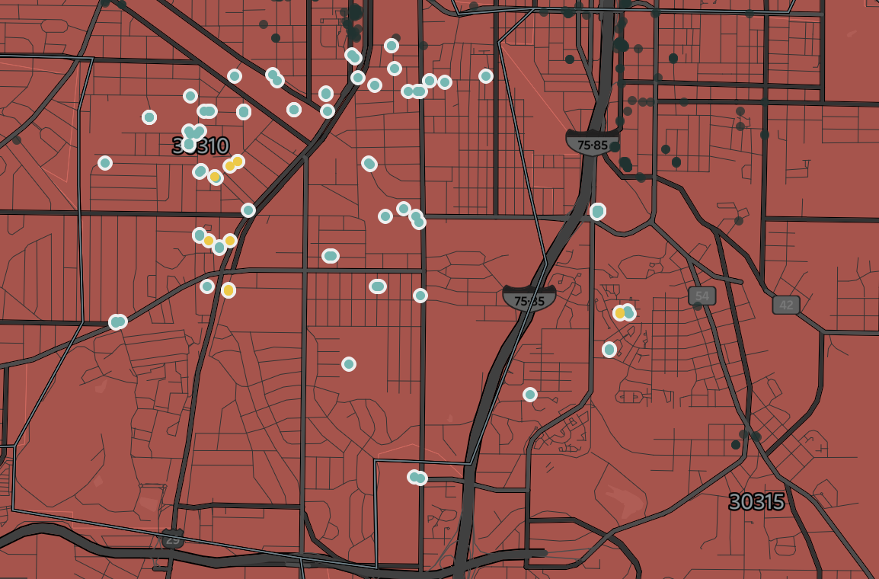
GeoSpatial Analysis - Ride Pick Up
30308 and 30313 zip codes have the highest density in ride population.
There are very few rides starting from 30310, 30312 and 30314 where the population density is comparatively high.

Slide 19
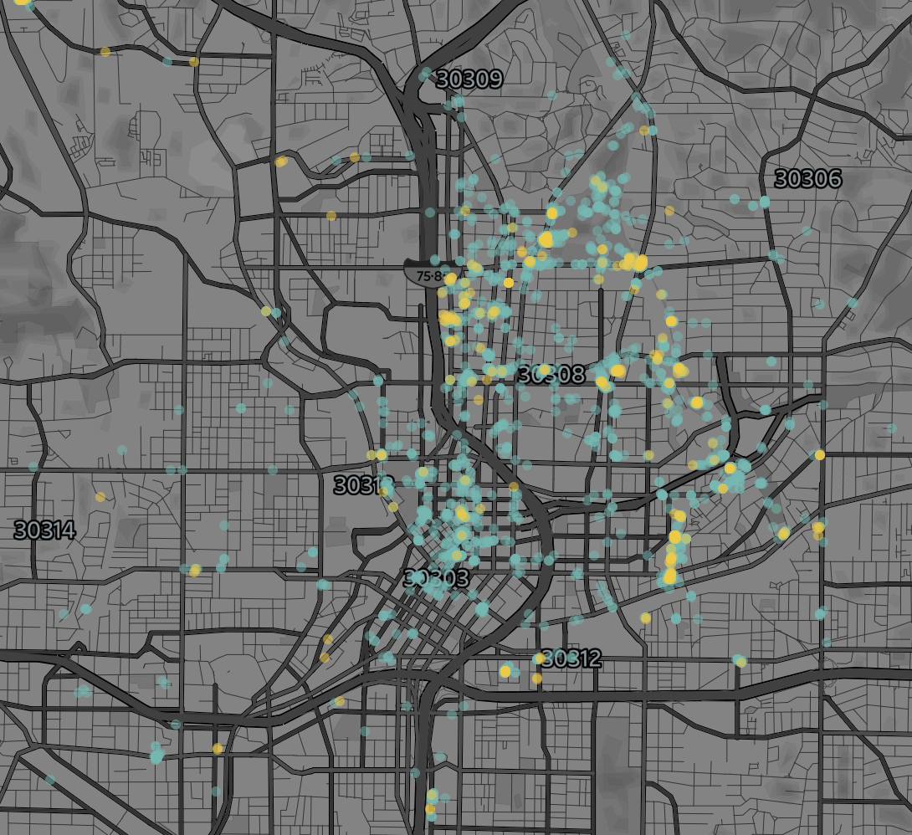
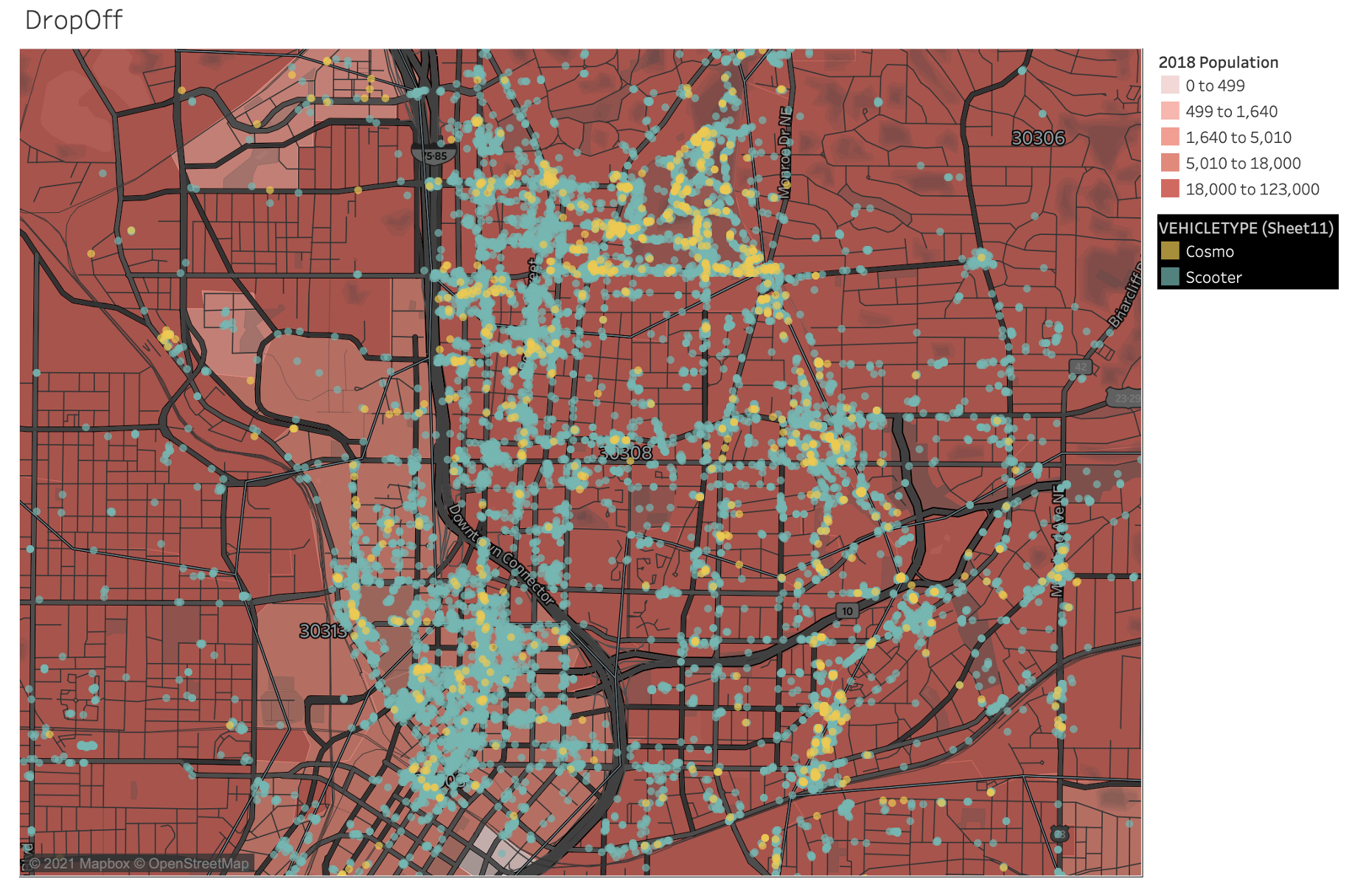
GeoSpatial Analysis - Ride Drop Off
Drop-offs after a non-ride event is more in zip code 30308, and 30313 compared to 30310, 30312, 30314 where the population is comparably denser.

Slide 20
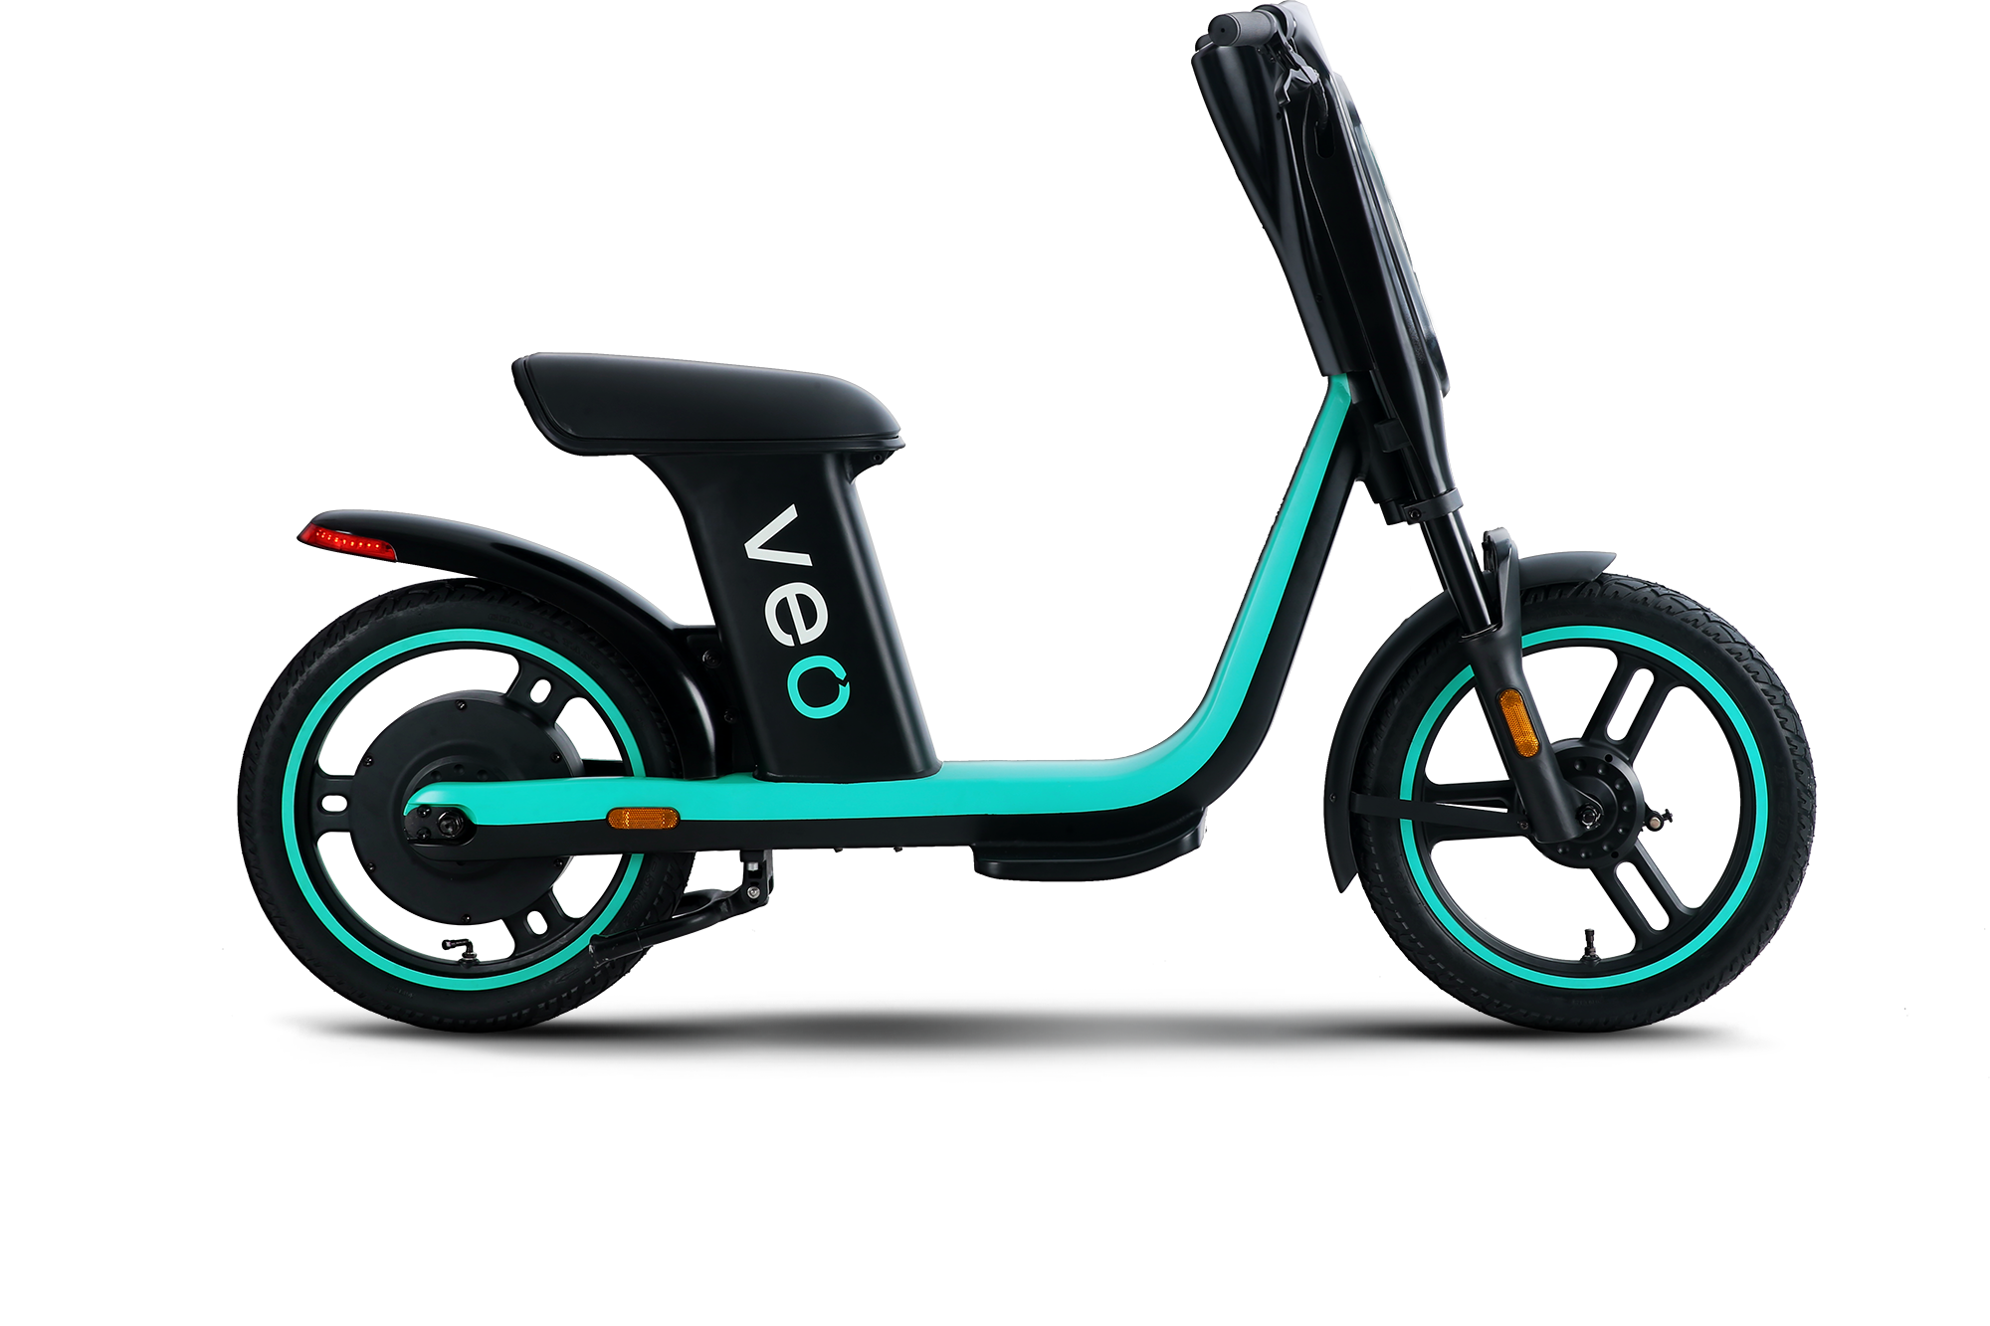
Summary
Most of the maintenance work is done on the weekends - Could look at BatteryPct of vehicles beforehand and do the maintenance before weekends.
To making sure to drop off the vehicle at full battery health.
To drop off vehicles at some nearby zip codes with high demand and high population.
Adding an EVENTID field would be beneficial, specifically for the Non-ride events i.e., it can give us a chronological order of the events.

